Slide 1

DATA TYPE & CONTROL STMT
CitiusTech has prepared the content contained in this document based on information and knowledge that it reasonably believes to be reliable. Any recipient may rely on the contents of this document at its own risk and CitiusTech shall not be responsible for any error and/or omission in the preparation of this document. The use of any third party reference should not be regarded as an indication of an endorsement, an affiliation or the existence of any other kind of relationship between CitiusTech and such third party

Slide 2
Variables
A variable is a “named container” that holds a value.
The programmer gives names to variables.
Variables can be of different data types: int, char, double, boolean, etc.
Variables can hold objects; then the type is the class of the object.
Names usually start with a lowercase letter.
A variable must be declared before it can be used
Notes:
The code in the green box is 8086 assembly language for IBM PC; ax and bx are general-purpose registers; move is the move instruction.

Slide 3
Variable names (cont’d)
Syntax: a variablename can include:
upper- and lowercase letters
digits
underscore characters
Syntax: A variablename cannot begin with a digit.
Style: variablenames should be descriptive to improve readability.
Notes:
Underscore in names is not common in Java. Names can also contain $, but this is not common either.

Slide 4
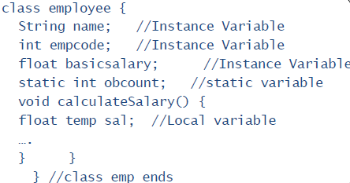
Three types of variables:
Instance variables
Instantiated for every object of the class.
Static variables
Class Variables
Not instantiate for every object of the class.
Local variables
Declared in methods and blocks.

Slide 5
Data Types
Value types
(Primitive)
byte (1 Byte)
short (2 Byte)
int (4 Byte)
long (8 Byte)
float (4 Byte)
double (8 Byte)
char (2 Byte)
boolean (1 Bit)
Reference
(Non Primitive)
String
arrays
classes
interfaces

Slide 6
Default Values of Fields
Type | Default value
boolean | false
byte | 0
char | '\u0000'
short | 0
int | 0
long | 0l
float | 0.0f
double | 0.0d
Object | null
Array | based on Array type

Slide 7
Type conversion and casting
Conversion : will take place when two types are compatible . Assign a smaller data type into bigger datatype.
Example : int = byte
long = int
Casting :will take place when a larger data type is assign into smaller datatype.
Example : byte = int
int = long
In this case compiler will generate an error .To avoid this we need to cost this explicitly.
Example : byte b; int i ; long l;
b=(byte) i;
i=(int) l;

Slide 8
Type promotion rules
In arithmetic expressions automatic type promotion take place.
All byte and short value will promoted into int.
If one operand is long the whole expression will be promoted in long.
If one operand is float the whole expression will be promoted in float.
If one operand is double the whole expression will be promoted in double.

Slide 9
Array in JAVA
An array is group of similar type of element referred by a common name.
Syntax : Type arr_name [ ] =new Type [size];
Type[] arr_name = new Type [size];
Arrays can be of two type..
1)single dimensional array
int student [ ] =new int [ 10 ];
2)multidimensional array
int arr [ ] [ ] =new int [ 10 ][10];
int arr[] = {2,3,4,5};

Slide 10
Arrays of objects too can be created:
Example 1:
Box Barr[] = new Box[3];
Barr[0] = new Box();
Barr[1] = new Box();
Barr[2] = new Box();
Example 2:
String[] Words = new String[2];
Words[0]=new String(“Bombay”);
Words[1]=new String(“Pune”);

Slide 11
Escape sequences
Sequence | Purpose
\b | Backspace
\t | Horizontal tab
\n | Line feed
\f | Form feed
\r | Carriage return
\" | Double quote
\' | Single quote
\\ | Backslash
\uxxxx | Unicode character

Slide 12
Reserved Words
In Java a number of words are reserved for a special purpose.
Reserved words use only lowercase letters.
Reserved words include:
primitive data types: int, double, char, boolean, etc.
storage modifiers: public, private, static, final, etc.
control statements: if, else, switch, while, for, etc.
built-in constants: true, false, null
Notes:
See Java Methods p. 125.
Note that the same words with a capital letter or in all caps are not reserved, but it is not a good idea to use them in programs anyway.

Slide 13
Keywords in Java
abstract | double | int | strictfp **
boolean | else | interface | super
break | extends | long | switch
byte | final | native | synchronized
case | finally | new | this
catch | float | package | throw
char | for | private | throws
class | goto * | protected | transient
const * | if | public | try
continue | implements | return | void
default | import | short | volatile
do | instanceof | static | while
enum**** | assert***
* indicates a keyword that is not currently used ** indicates a keyword that was added for Java 2
*** new in J2SE 1.4
**** new in J2SE 5.0

Slide 14
Operators in Java
Arithmetic operators: + , - , * , / , %
++,--,+=,-=,*=,/=,%=
Bitwise Operators: &, |, ^, ~ , <<, >>,>>>
Relational Operators : <, >, <=, >=, !=, ==
Logical Operators: &,|,^,||,&&,!
Assignment Operators : =
Conditional or ternary operator:
(condition) ? (if part) : (else part)

Slide 15
Instance Of Operators
The instanceof operator compares an object to a specified type
Checks whether an object is:
An instance of a class.
An instance of a subclass.
An instance of a class that implements a particular interface.
The following returns true:
new String("CitiusTech") instanceof String;

Slide 16
Formats for Comments
A “block” comment is placed between /* and */ marks:
A single-line comment goes from // to the end of the line:
/* Exercise 5-2 for Java Methods
Author: Miss Brace
Date: 3/5/2010
Rev. 1.0 */
weight *= 2.2046; // Convert to kilograms
Notes:
Make sure you do not carry a // comment over to the next line. If you do, you need another // mark on that line.
Placing // at the beginning of a line comments out that line.
Java does not allow nested /* */ comments: /* ... */ within /* ... */ does not work. Be careful when you use /* ... */ to comment out a fragment of code that itself contains a /* ... */ comment.

Slide 17
Control statements
Control statement are use to control the flow of execution of the program . Control statement can be put into following categories..
Selection
If – else (multiple if , ladder if –else , nested if –else)
switch
Iteration
for
while
do - while
Jump
break
continue
Labeled break/continue

Slide 18
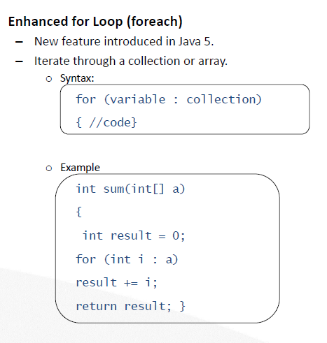
Enhance for loop

